Slide 1

FAQ RAG APPLICATION
Gen Ai Project
Tools: LangChain, Hugging Face, Mistral(LLM), FAISS, Streamlit, PyCharm
Maryam Farooq
Data Science trainee
@Knowledge Streams
LinkedIn | Github

Slide 2
Contents
Problem Statement
Proposed Solution
Methodology
Challenges
Technical Details
Future Scope

Slide 3
Problem Statement
Knowledge Streams, a corporate training institute, struggles with managing Large volume of FAQs all across Pakistan.
Challenges include handling diverse topics and ensuring timely responses.
Current methods are resource-intensive and inefficient.

Slide 4
Contents
Problem Statement
Proposed Solution
Methodology
Challenges
Technical Details
Future Scope

Slide 5
Proposed Solution
Develop a FAQbot using Retrieval-Augmented Generation (RAG).
Integrate diverse FAQs from Knowledge Streams for accurate query responses.
Enhance user interaction with efficient and accurate answers.

Slide 6
Contents
Problem Statement
Proposed Solution
Methodology
Challenges
Technical Details
Future Scope

Slide 7
Retrieval Augmented Generation
RAG is a technique for augmenting LLM knowledge with additional data.
A typical RAG application has two main components:
Indexing (Data Ingestion and Vectorization)
Retrieval and generation

Slide 8
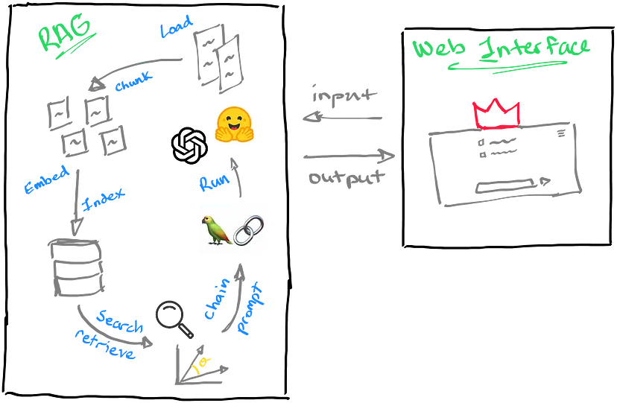

Slide 9
Contents
Problem Statement
Proposed Solution
Methodology
Challenges
Technical Details
Future Scope

Slide 10
Data Creation
Data was scattered across multiple documents and Excel files, making organization a major challenge.
Miss Komal, Marketing Head Miss Kiran, and team, especially Miss Amna, worked iteratively on data creation.
Their collaboration was crucial in overcoming data challenges and ensuring project success.

Slide 11
Contents
Problem Statement
Proposed Solution
Methodology
Challenges
Technical Details
Future Scope

Slide 12
Tools
LangChain: Framework to develop LLM powered Apps
Fast Embeddings: Text Embeddings
FAISS: Vector Database
Mistral: LLM model from Hugging face
Streamlit: To build data apps
PyCharm: IDE for python apps

Slide 13
Technical Details
Data Pre – Processing
Indexing Pipeline
Data Ingestion
Data Vectorization
RAG Chain
Streamlit App

Slide 14
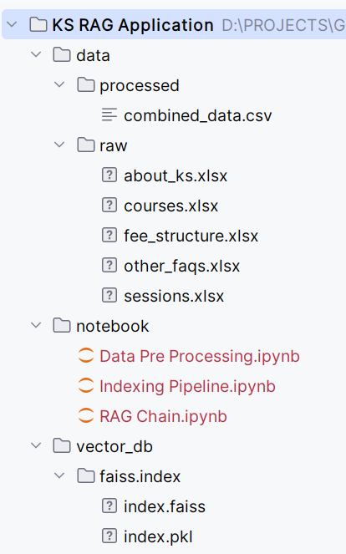
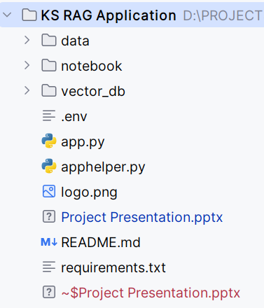
Project Structure

Slide 15
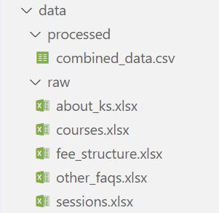
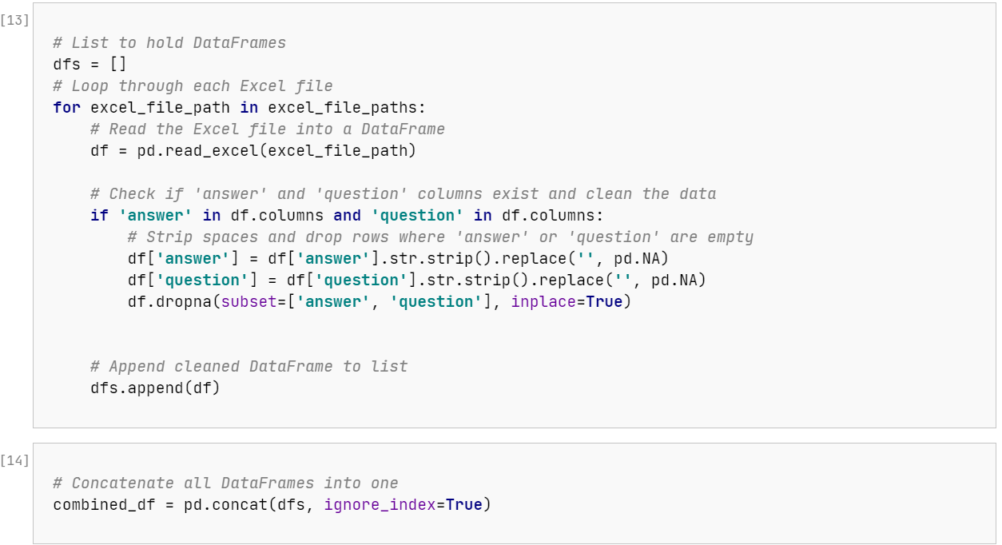
Data Pre - processing

Slide 16
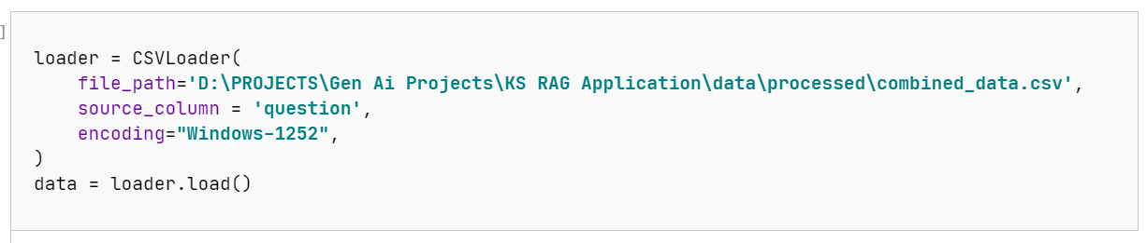
Indexing (Data Ingestion)
from langchain.document_loaders import CSVLoader

Slide 17
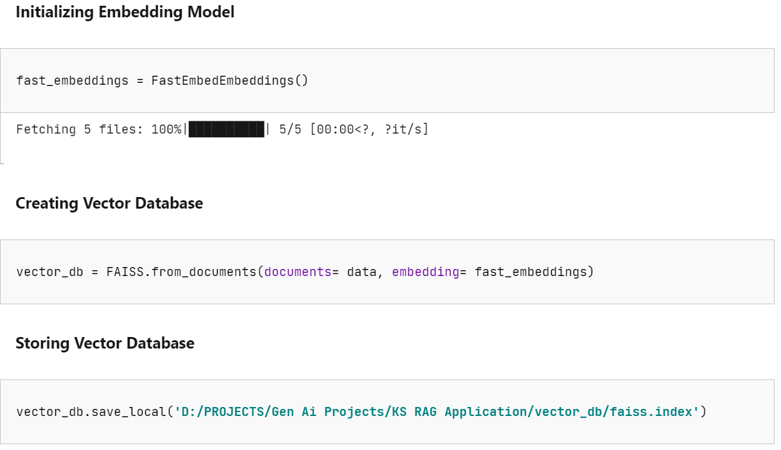
Indexing (Data Vectorization)
from langchain_community.embeddings.fastembed import FastEmbedEmbeddings
from langchain.vectorstores import FAISS

Slide 18
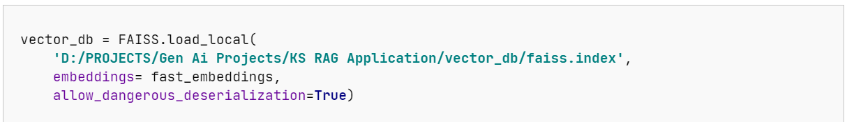
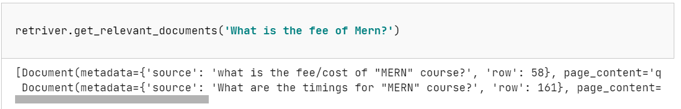
Retrieval
from langchain.vectorstores import FAISS
from langchain.chains import RetrievalQA

Slide 19
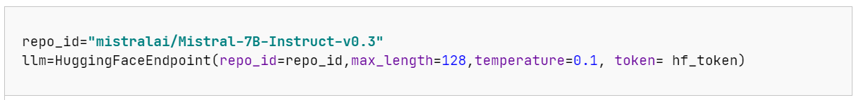
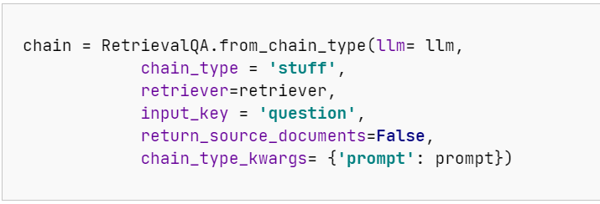
Generation
from langchain_huggingface import HuggingFaceEndpoint
from langchain.chains import RetrievalQA

Slide 20
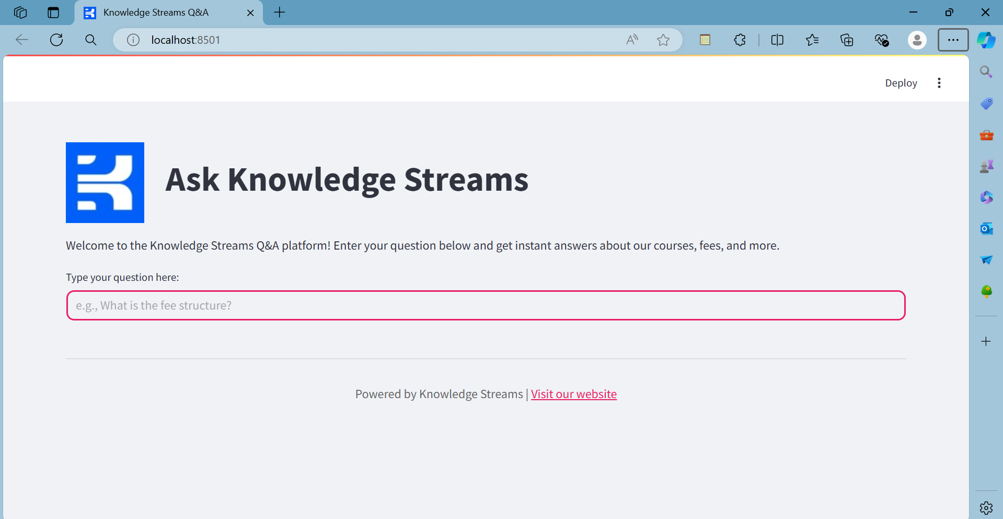

Slide 21
Contents
Problem Statement
Proposed Solution
Methodology
Technical Details
Future Scope

Slide 22
Expand Knowledge Base
Continuously update and expand the FAQ database with new queries and detailed answers.
Incorporate feedback from users to identify and address gaps in the current knowledge base.
Integration with Social Media and Messaging Platforms
Extend the chatbot’s reach by integrating it with popular social media platforms and messaging apps. Ensure consistent and responsive interactions across all channels.
Lead Generation and Marketing Integration
Collect and store all user queries along with their names and contact details.
Export collected data into CSV files for the marketing team to use for lead generation and follow-up.
Implement data analytics to identify potential leads and target them with personalized marketing campaigns.

Slide 23
4. Context-Aware Chatbot:
Develop the application into a full-fledged chatbot that maintains the context of the conversation.
Use contextual understanding to provide more accurate and relevant responses to follow-up questions.
5. Internal Query Handling for Registered Students:
Enable registered students to ask admin-related queries, such as fee status, course progress, and schedule.
Integrate with the student database to fetch and provide accurate responses to these queries.
6. Enhanced User Data Management:
Implement a user profile management system to keep track of user interactions, preferences, and history.
Use this data to personalize responses and recommendations.

